Slide 1
ChemCorp INSIGHTS for future investments
HANDE TOKGOZ UTKU

Slide 2
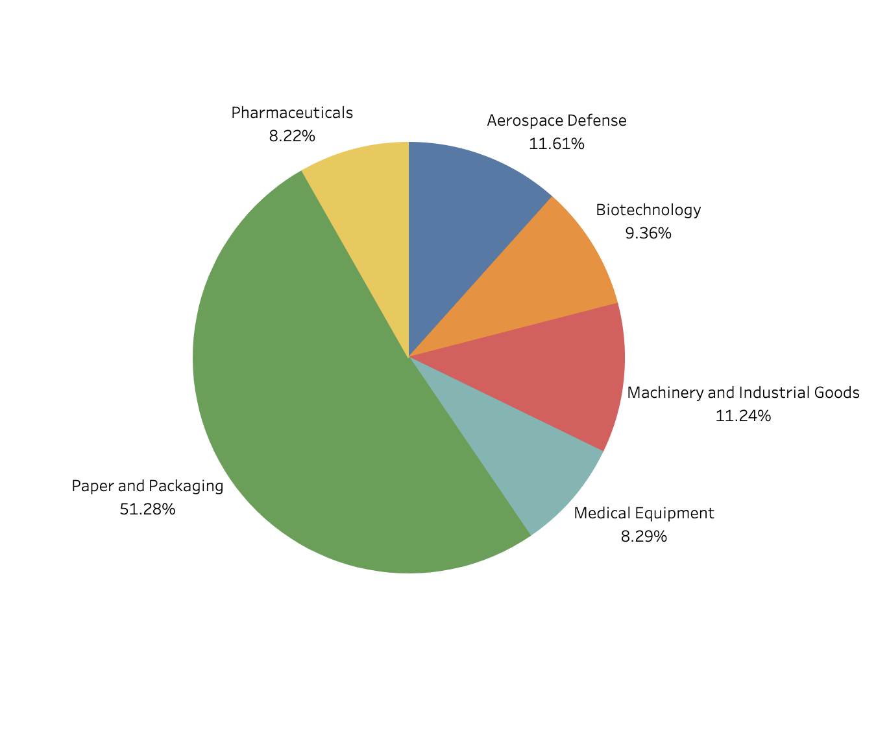
EXEC SUMMARY Revenue Per COMPANY TYPE
There is a clear need to define which customer segments and products to invest in the upcoming period.
Just to begin the conversation, more than half of our revenue comes from Paper and Packaging companies. The rest of the revenue distribution is pretty even.
Paper and Packaging segment would be very ideal to increase our investments.
Let’s have a look at the drivers of revenue and profit for those segments and the set of chemicals we provide.

Slide 3
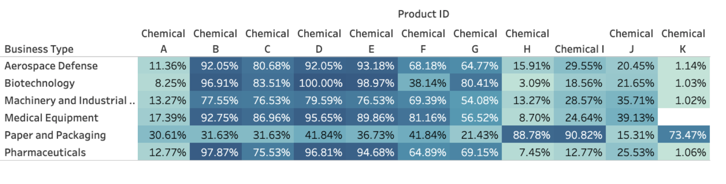
% Products per segment
Chemical B, D and E are used by almost all companies in Aerospace Defense, Biotechnology, Medical Equipment and Pharmaceuticals sector.
In addition to that, medical equipment companies use Chemical F, Biotechnology companies use Chemical G more than others.
Paper and Packaging needs totally different chemicals, weighing in for Chemicals H and I.

Slide 4
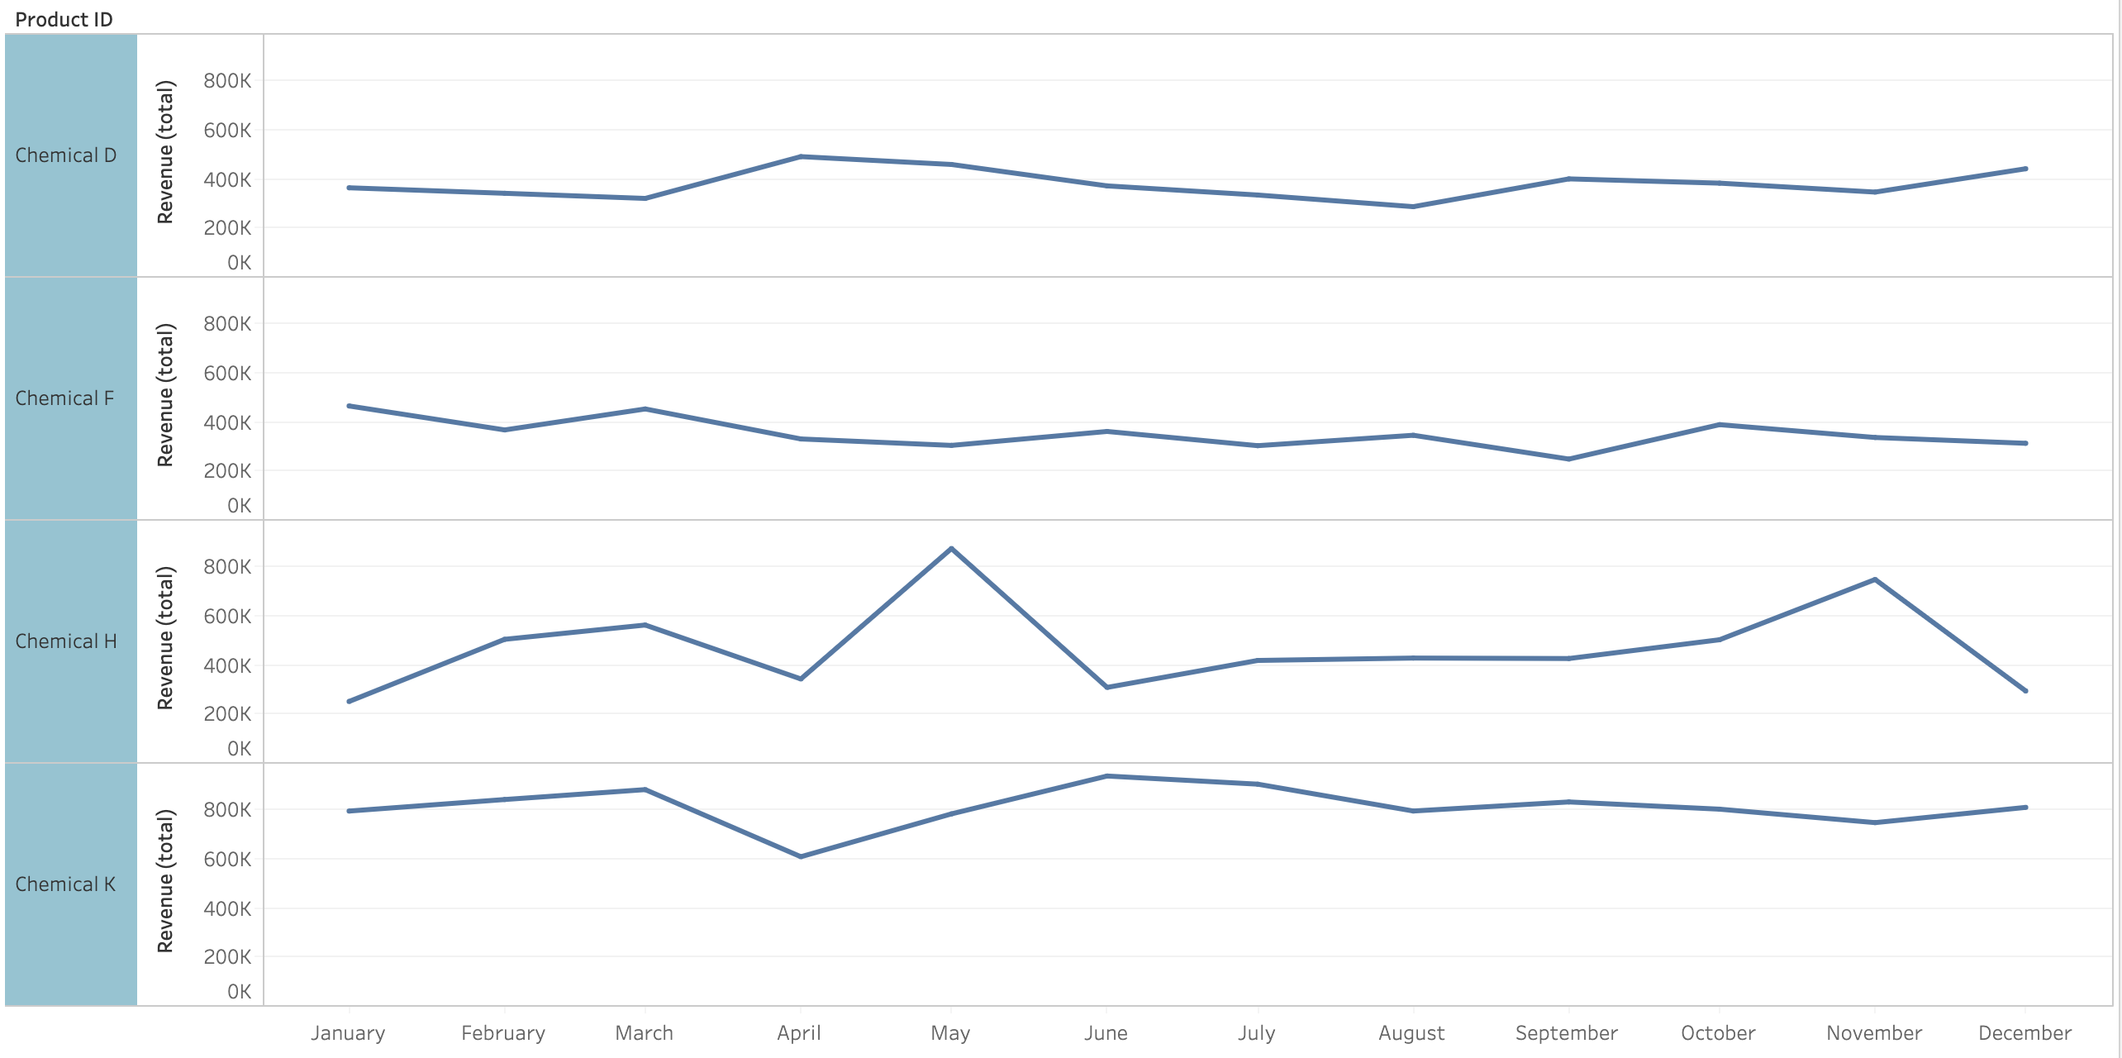
SEASONALITY high for chemical h
Chemicals H and K are the ones that show the most seasonality. Demand for K drops in April. Demand for H increases in May and November.
Chemical D and F also show minor seasonality.
We should be ready for increased Chemical H demand in May and November to maximize revenue.

Slide 5
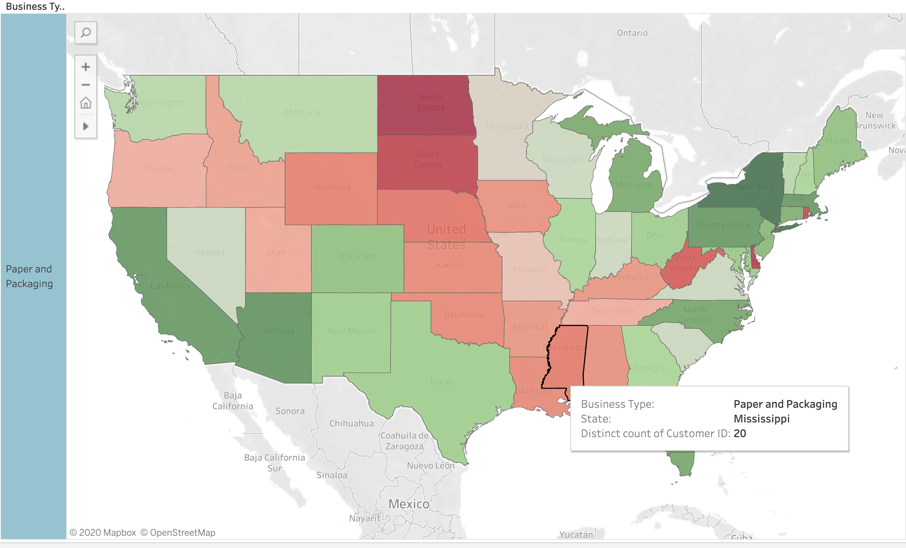
PAPER AND PACKAGING IN NORTH AND SOUTH DAKOTA
The largest customer segment, Paper and Packaging is concentrated in South Dakota and North Dakota, as well as Delaware and West Virginia. It might be a good idea to invest on that vertical in those states.

Slide 6
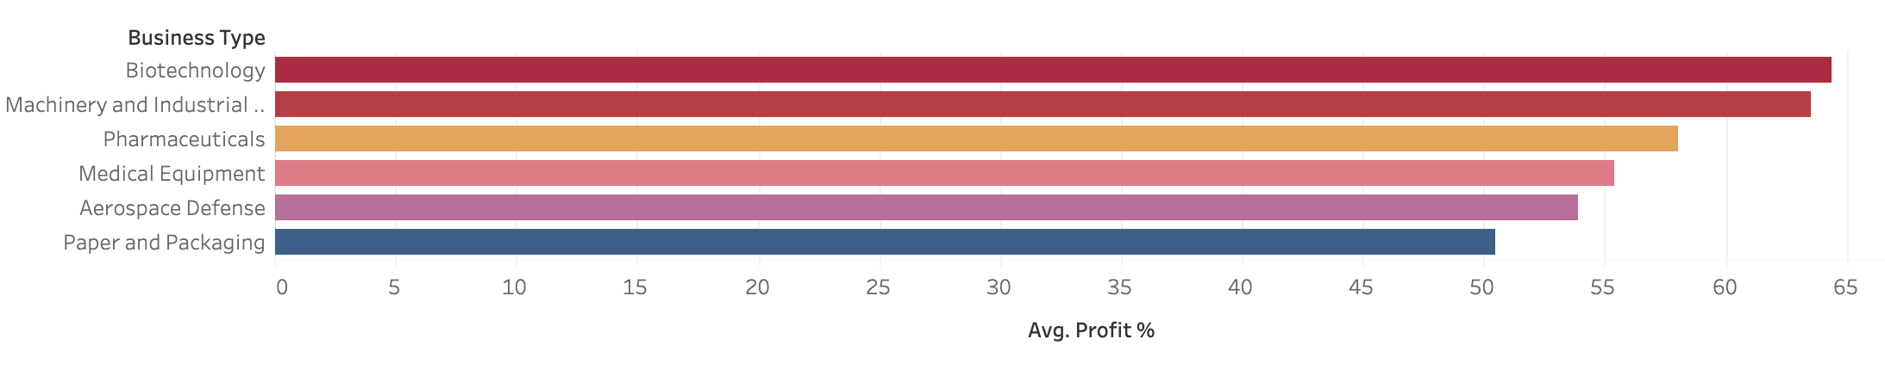
High profits in biotech and machinery&industrial
The most profitable segments are Biotechnology and Machinery&Industrial.
Increasing our market share for those industries would lead to higher profits overall.
Despite its size in our book of business, Paper and Packaging companies are the least profitable.

Slide 7
Revenue Per COMPANY TYPE
The number of businesses for Machinery&Industrial in the market is huge. This shows us an opportunity to work with more companies in that segment which is profitable.
The market distribution is not proportional with our book of business. There is room for growth in Machinery and Medical Equipment companies.

Slide 8
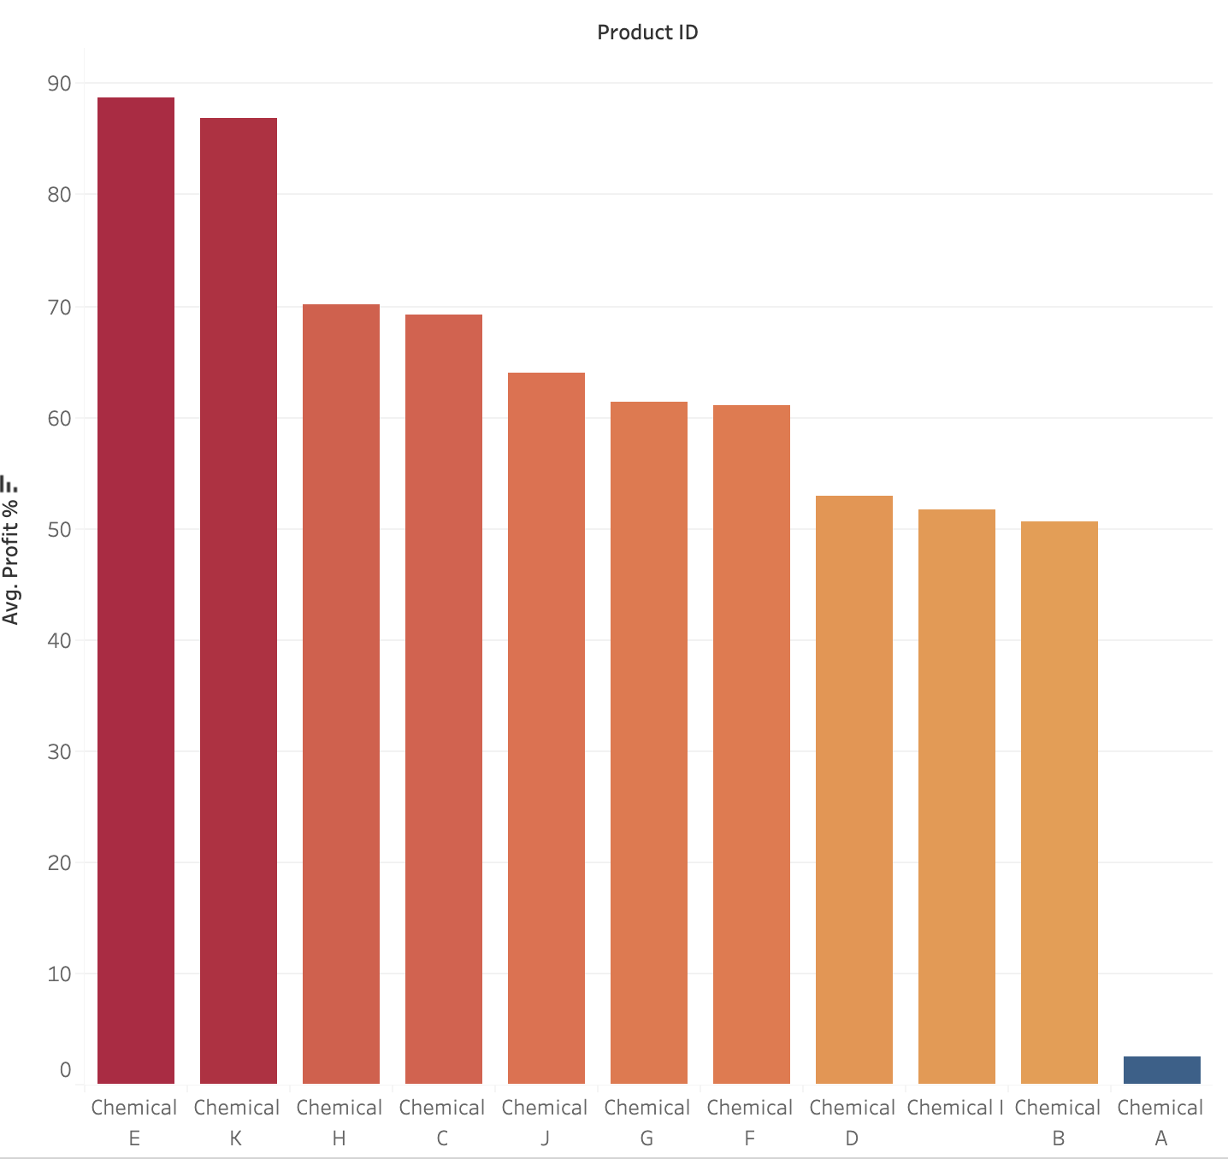
Profit % per product for machinery&industrial
Chemical E and Chemical K are the products that are driving the profitability for Machinery and Industrial.
When growing into that segment, we should focus on promoting Chemical E and Chemical K even more.
Chemical A generates an extremely low profit in this segment.

Slide 9
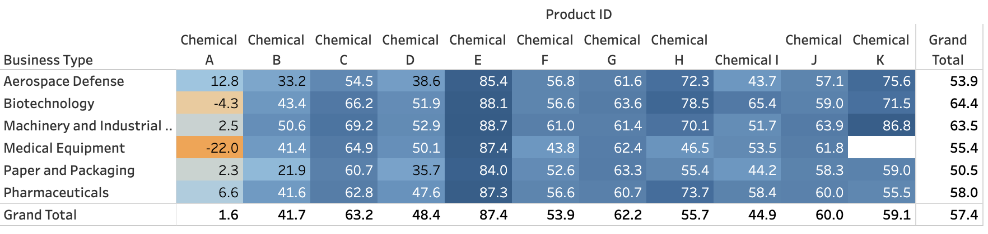
Products to divert products to invest
We should either divert from Chemical A entirely or limit our operations for this product to Aerospace Defense or Pharmaceuticals segments.
The resources should instead be used for the highest profit products which are Chemical E or selling Chemical H to Aerospace Defense, Biotechnology, Pharmaceuticals; and Selling Chemical K to Machinery and Industrial.

